Slide 1
Online Shopping
N.NAGA SAIKIRAN
158W1F0034

Slide 2
Index
Abstract
Modules
Database Design
Software & Hardware Requirements
UML Diagrams
Class diagram
Usecase diagram
Activity diagram
Sequence diagram

Slide 3
Abstract
ONLINE SHOPPING
This system helps in buying used goods or products online by choosing the listed products from website. In day to day life, we will need to buy lots of goods or products from a shop. It may electronic items, house hold items etc. Now a days, it is really hard to get some time to go out and get them by ourselves due to busy life styles or lots of works. In order to solve this, B2C , E-Commerce websites have been started. Using these websites, we can buy goods or products online just by visiting the website and ordering the item online by making payments online

Slide 4
Abstract
EXISTING SYSTEM:
This existing system of buying goods has several disadvantages. It requires lots of time to travel to the particular shop to buy the goods. If user want to buy a new branded products we need more money. Also there are expenses for travelling from house to shop. More over the shop from where we would like to buy some thing may not be open 24*7*365. Hence we have to adjust our time with the shopkeeper’s time or vendor’s time.
PROPOSED SYSTEM:
The proposed system helps in building a website to buy products or goods online. Purchasing of Branded products with low cost price in online, user can choose different products based on categories like Brands etc. online payments , delivery services and hence covering the disadvantages of the existing system and making the buying is easier.

Slide 5
Modules
Login
Categories
Payments

Slide 6
Database Design
TABLES:
login
SNO | NAME | TYPE
1 | email | varchar
2 | password | varchar
customer
SNO | NAME | TYPE
1 | Customer_id | Primary key
2 | Customer_ip | varchar
3 | Customer_name | text

Slide 7
SNO | NAME | TYPE
4 | Customer_email | varchar
5 | Customer_pass | varchar
6 | Customer_country | text
7 | Customer_city | text
8 | Customer_contact | varchar
9 | Customer_address | text
10 | Customer_image | text
categories
SNO | NAME | TYPE
1 | Cat_id | Primary key
2 | Cat_title | text

Slide 8
Products
SNO | NAME | TYPE
1 | Product_id | Primary key
2 | Product_cat | int
3 | Product_brand | int
4 | Product_title | Varchar
5 | Product_price | int
6 | Product_desc | Text
7 | Product_image | Text
8 | Product_keywords | text

Slide 9
Brands
SNO | NAME | TYPE
1 | Brand_id | Primary key
2 | Brand_title | text
cart
SNO | NAME | TYPE
1 | P_id | Primary key
2 | Ip_add | varchar
3 | qty | int

Slide 10
Software requirements
Operating System : Windows all versions.
Front end: HTML, CSS, JavaScript.
HTML: HTML is used to create and save web document
CSS : (Cascading Style Sheets) Create attractive Layout
JavaScript: it is a programming language, commonly use with web browsers.
Back end: PHP, MySQL(WAMP Server)
PHP: Hypertext Preprocessor (PHP) is a technology that allows software developers to create dynamically generated web pages, in HTML, XML or other document types, as per client request.
MySQL: MySql is a database, widely used for accessing querying, updating, and managing data in databases.

Slide 11
Hardware requirements
Minimum hardware requirements for all windows versions
Architecture | 32-bit | 64-bit
Processor | 1 GHz x86 processor | 1 GHz x86 processor
Memory (RAM) | 512MB | 1GB
HDD free space | 16GB Free disk space | 20GB Free disk space

Slide 12
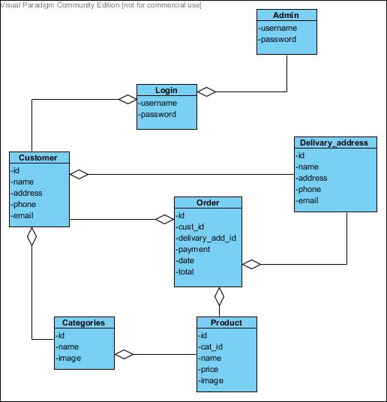
UML diagrams Class diagram

Slide 13
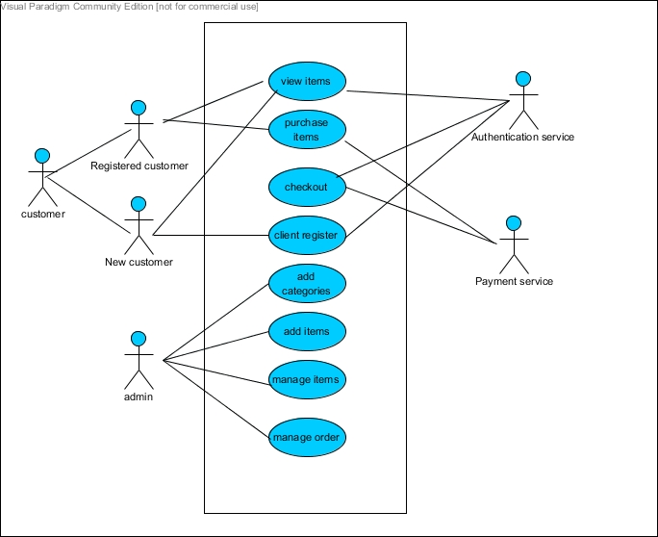
Usecase diagram

Slide 14
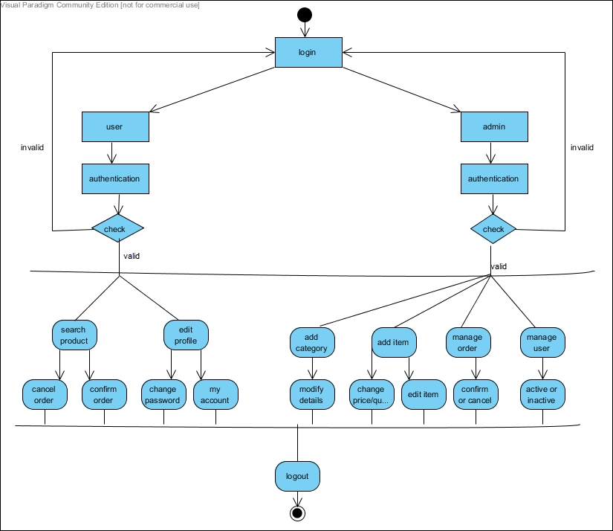
Activity diagram

Slide 15
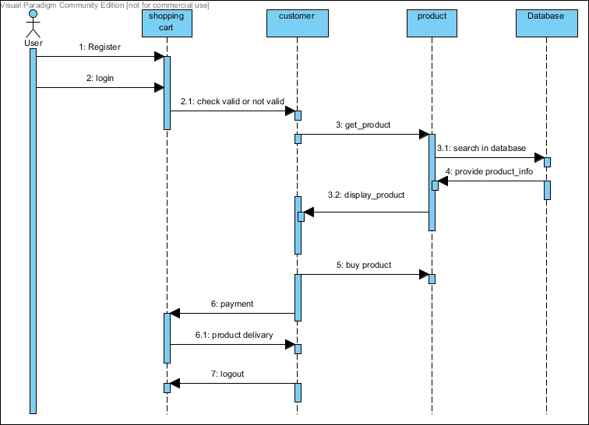
Sequence diagram

Slide 16
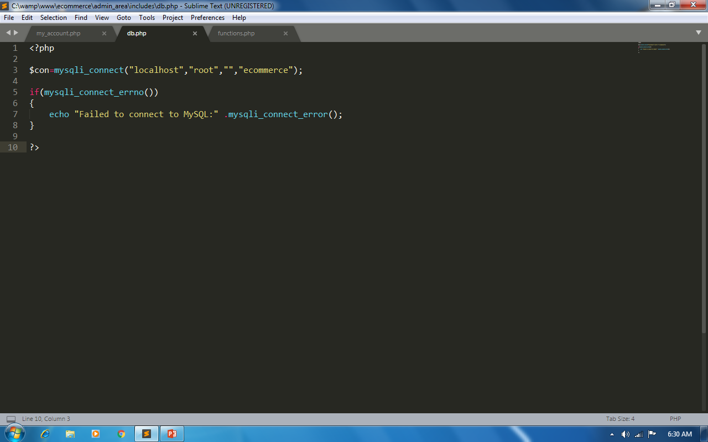

Slide 17
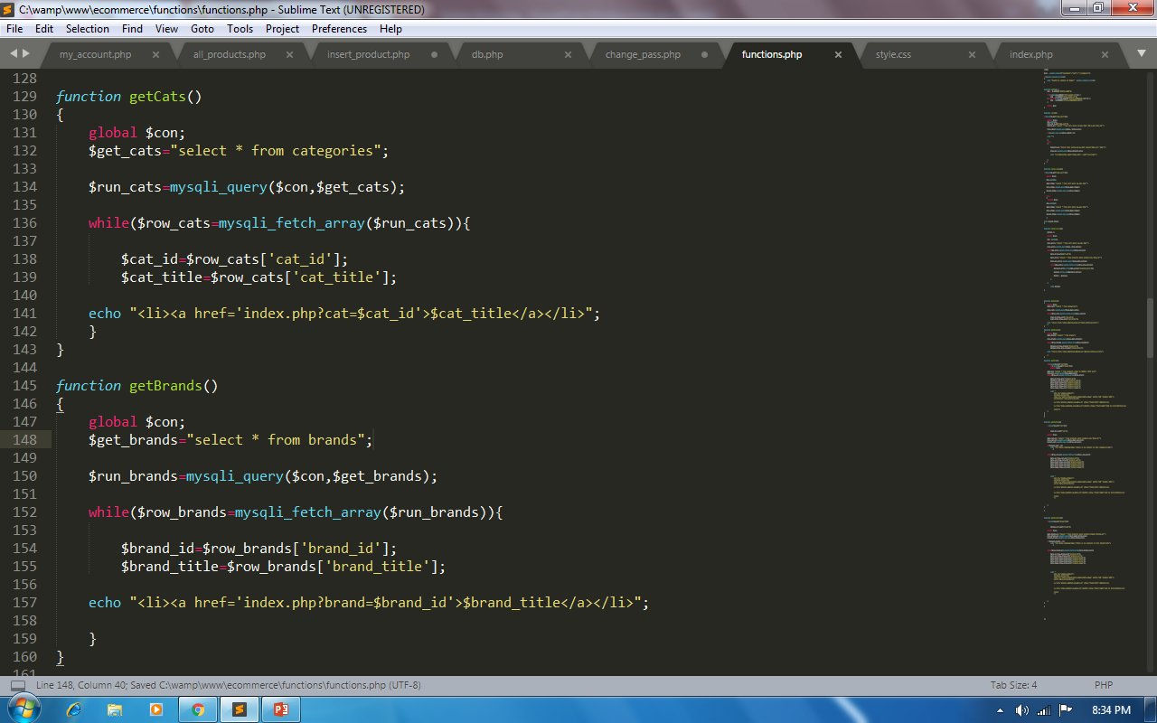

Slide 18
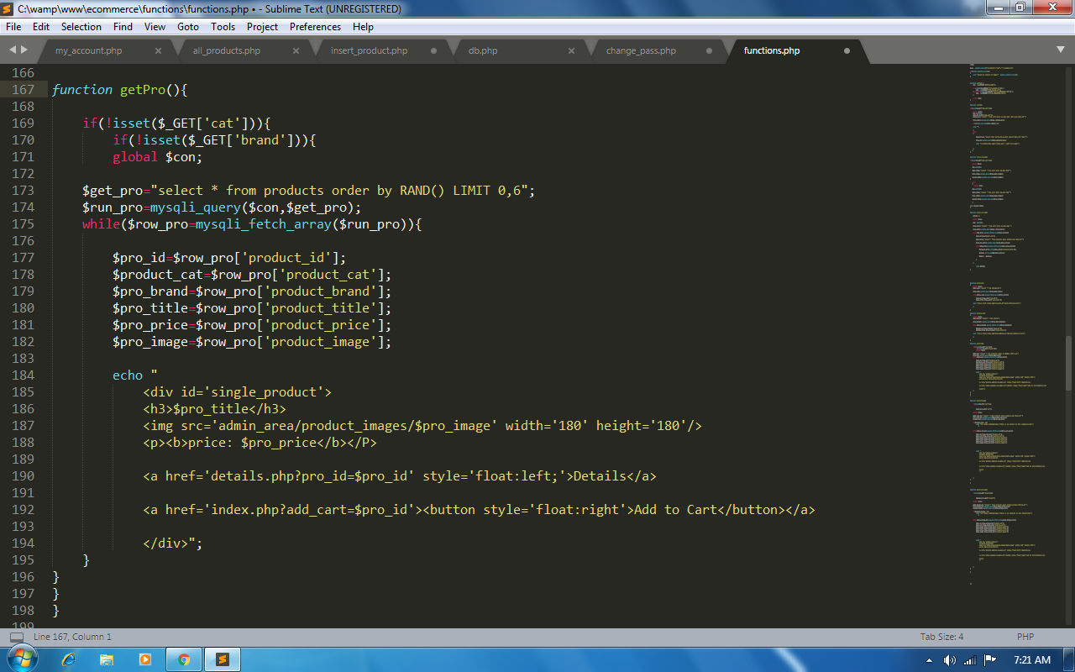

Slide 19
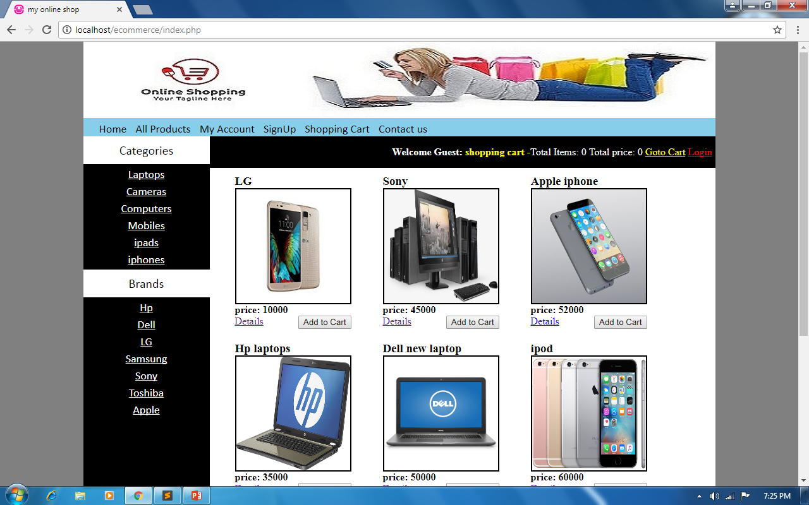

Slide 20
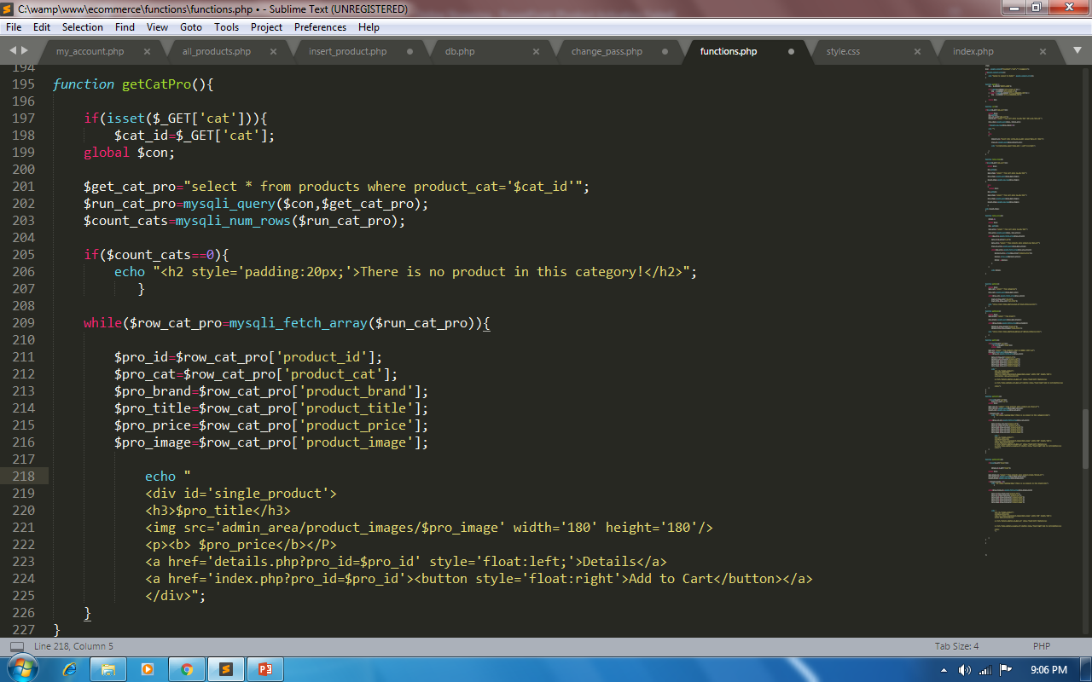

Slide 21
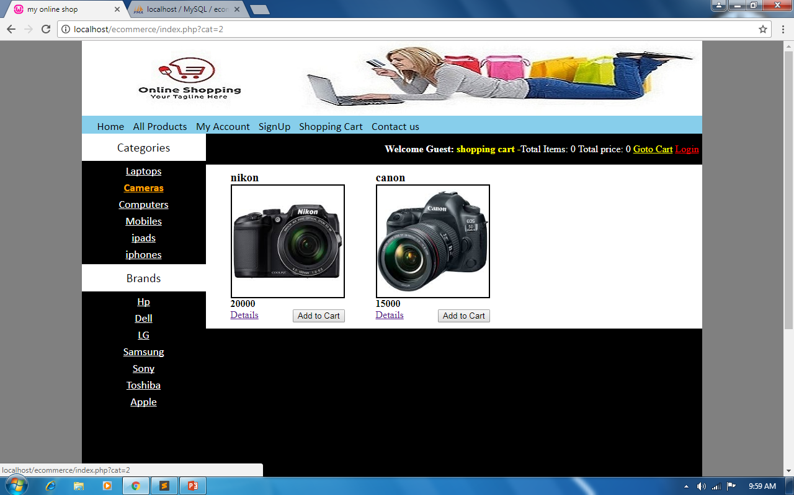

Slide 22
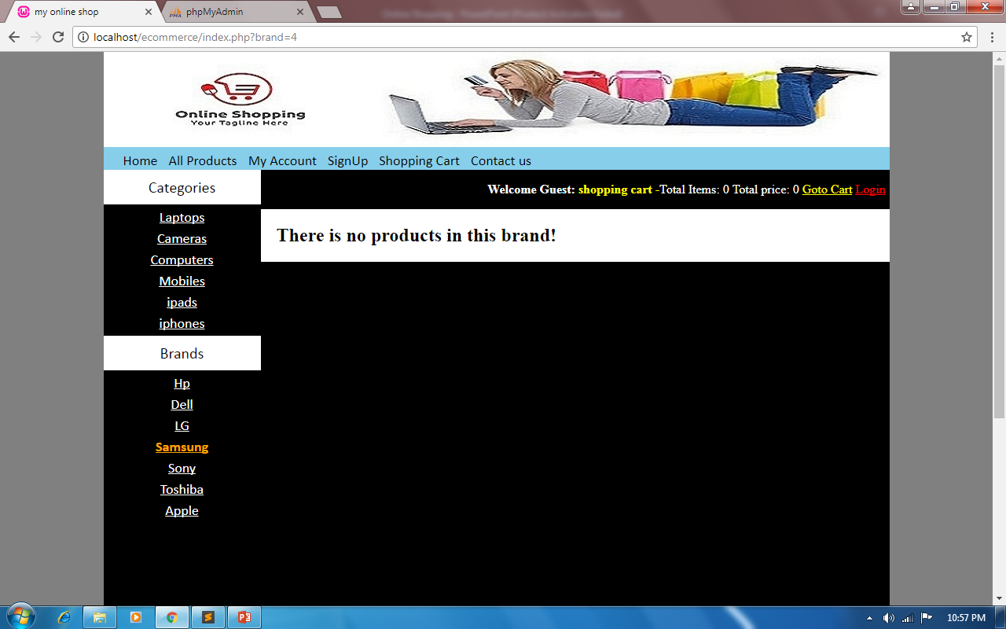

Slide 23
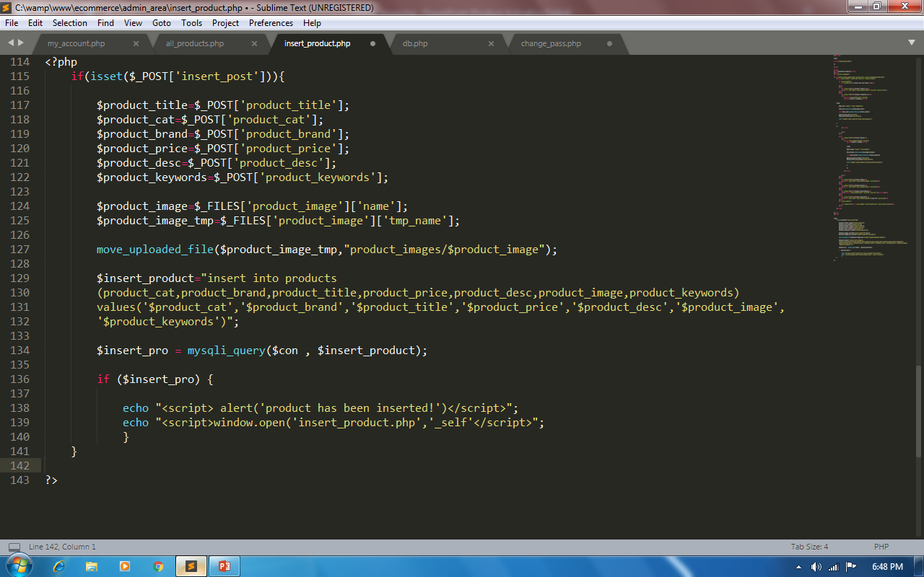

Slide 24
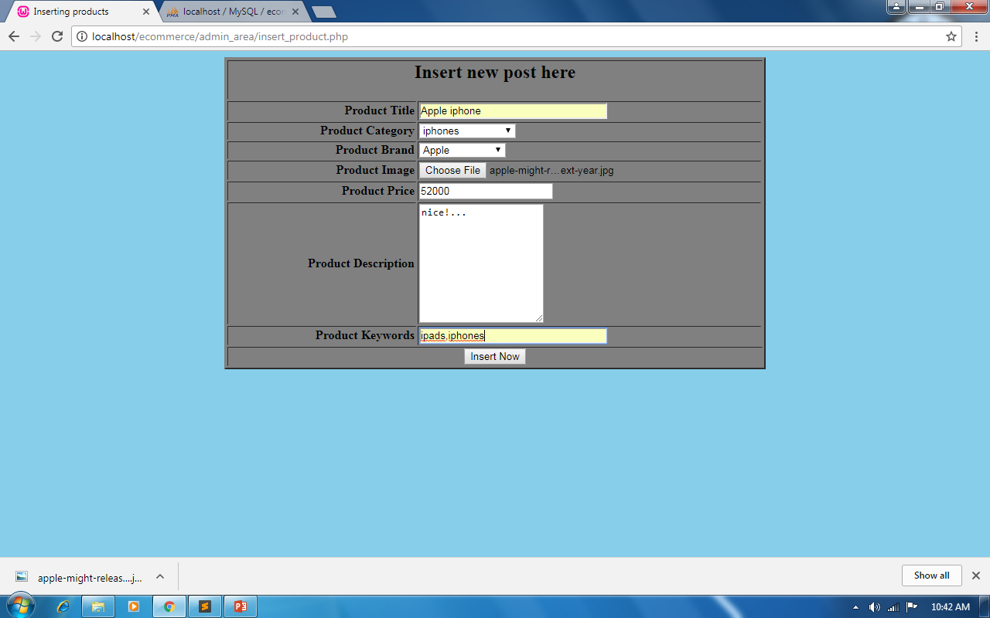

Slide 25
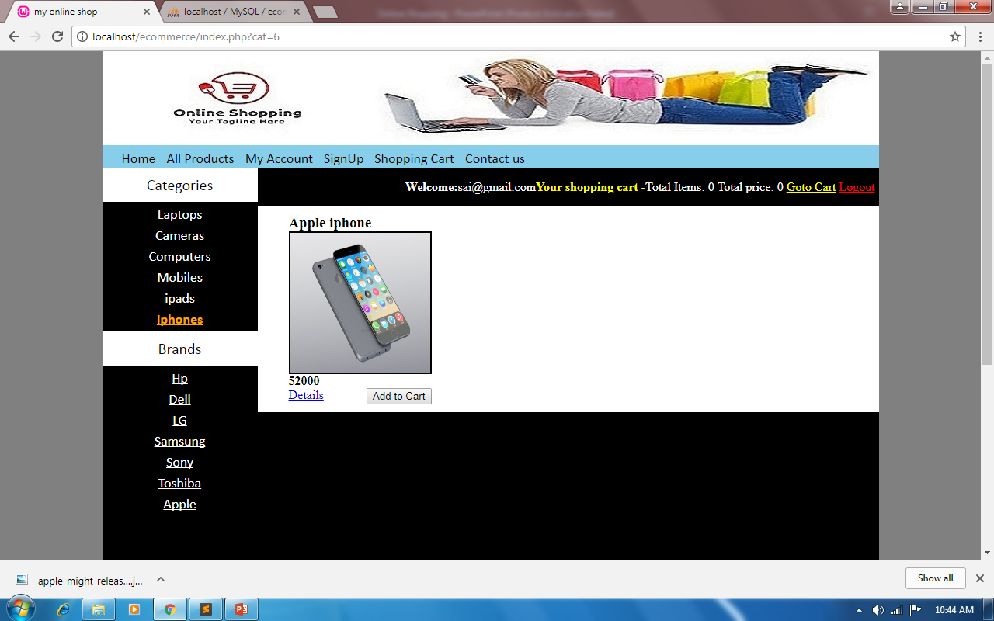

Slide 26
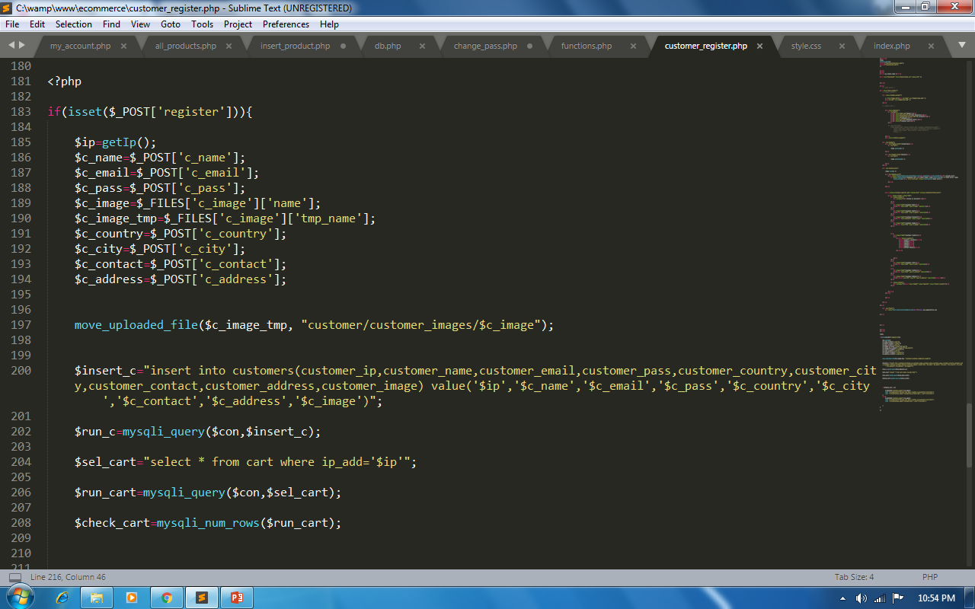

Slide 27
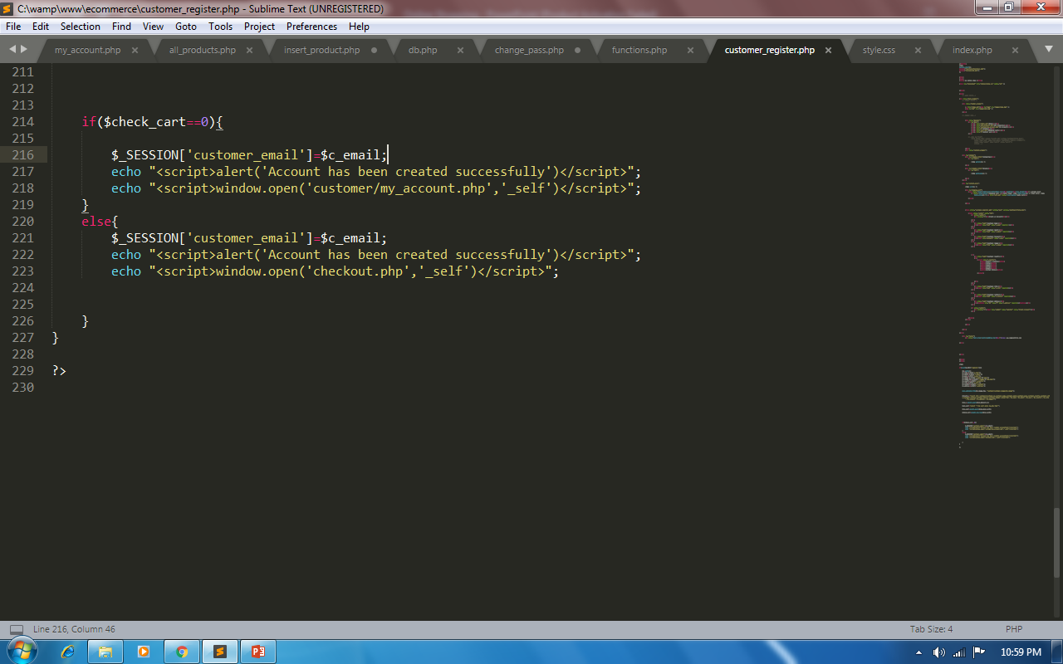

Slide 28
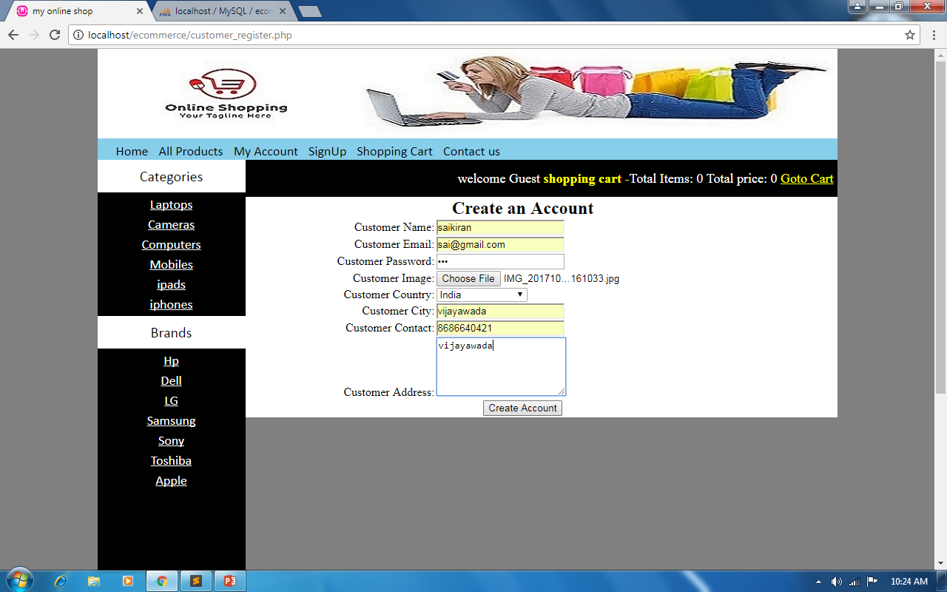

Slide 29
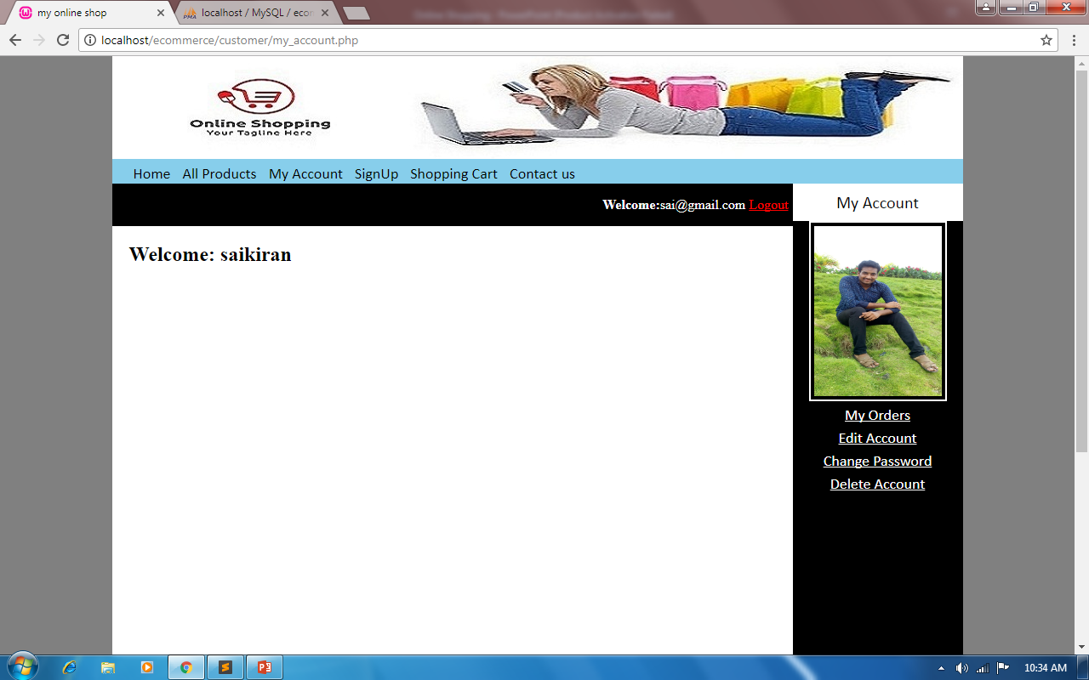

Slide 30
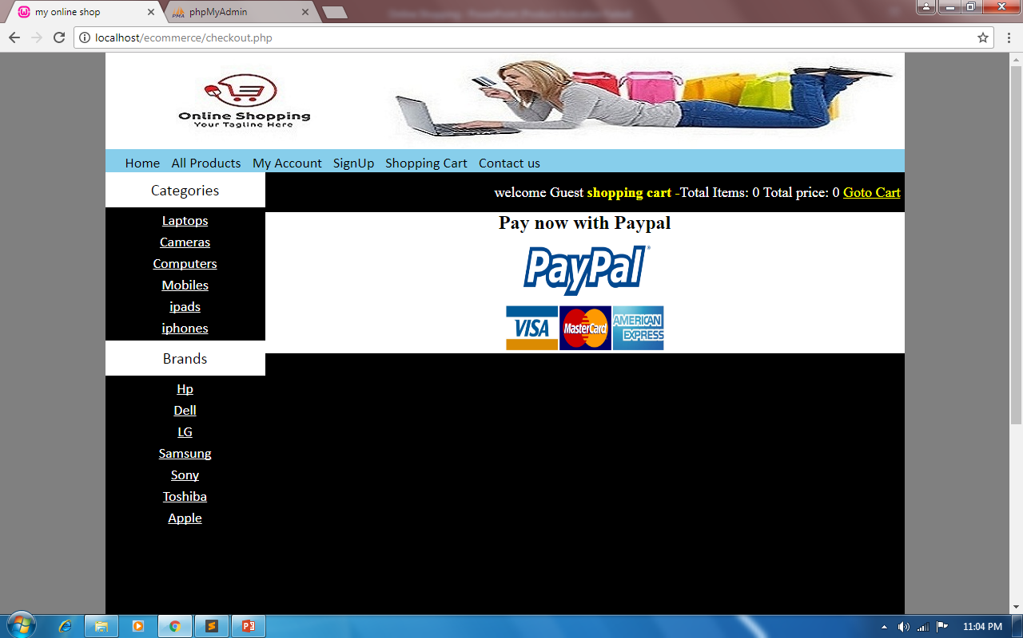

Slide 31
Thank You

